Slide 1




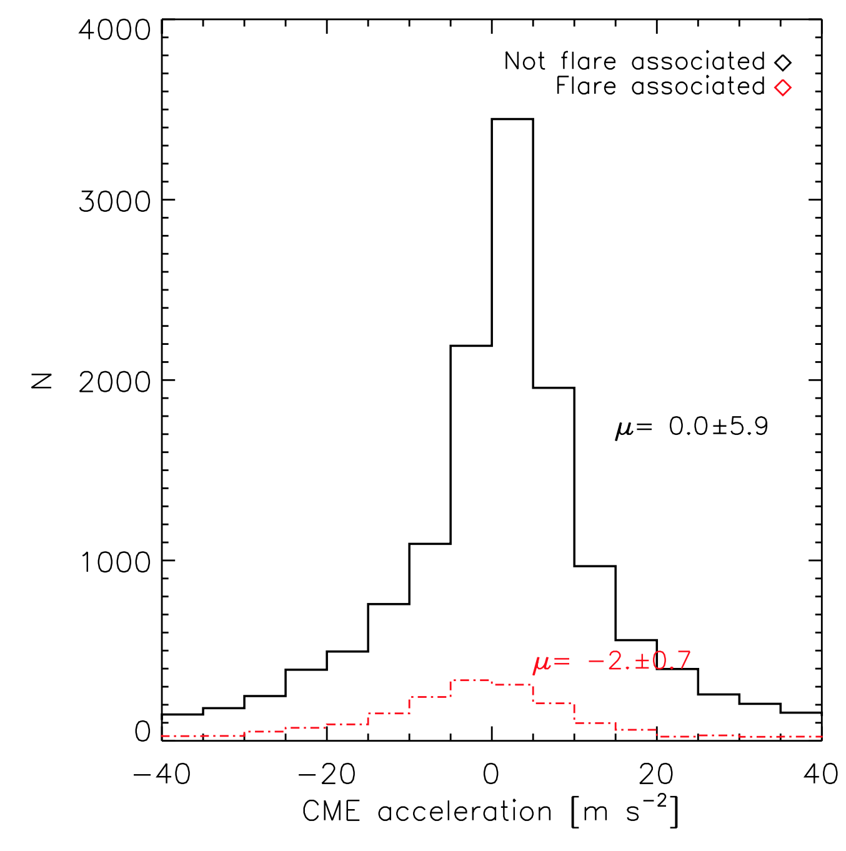
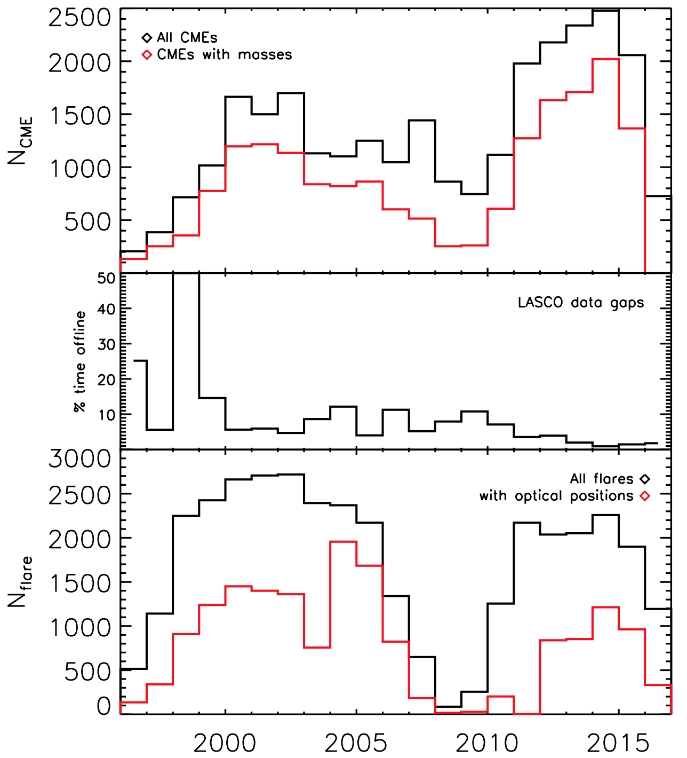
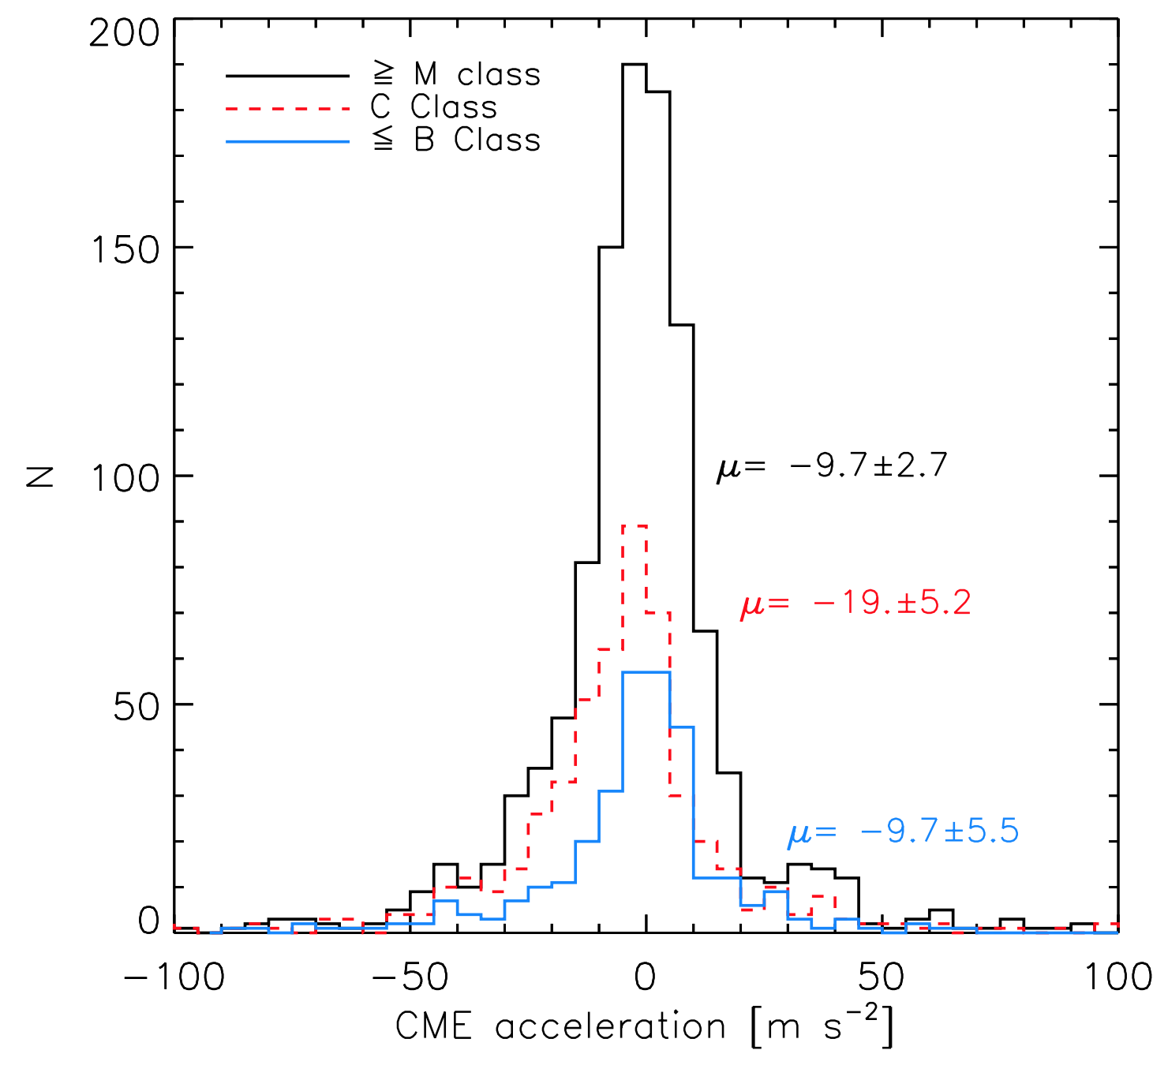
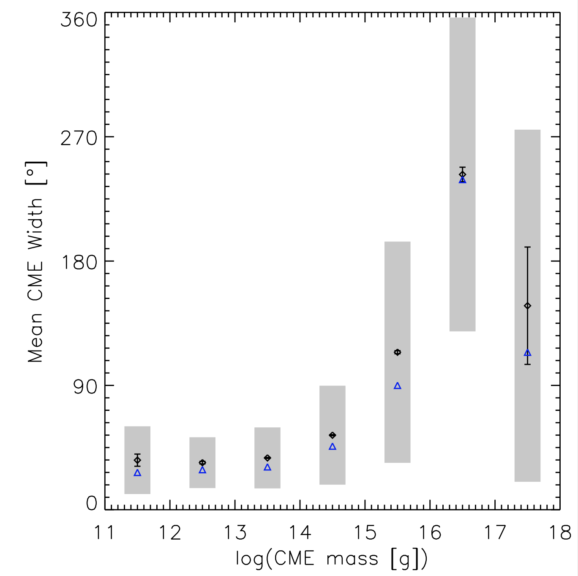
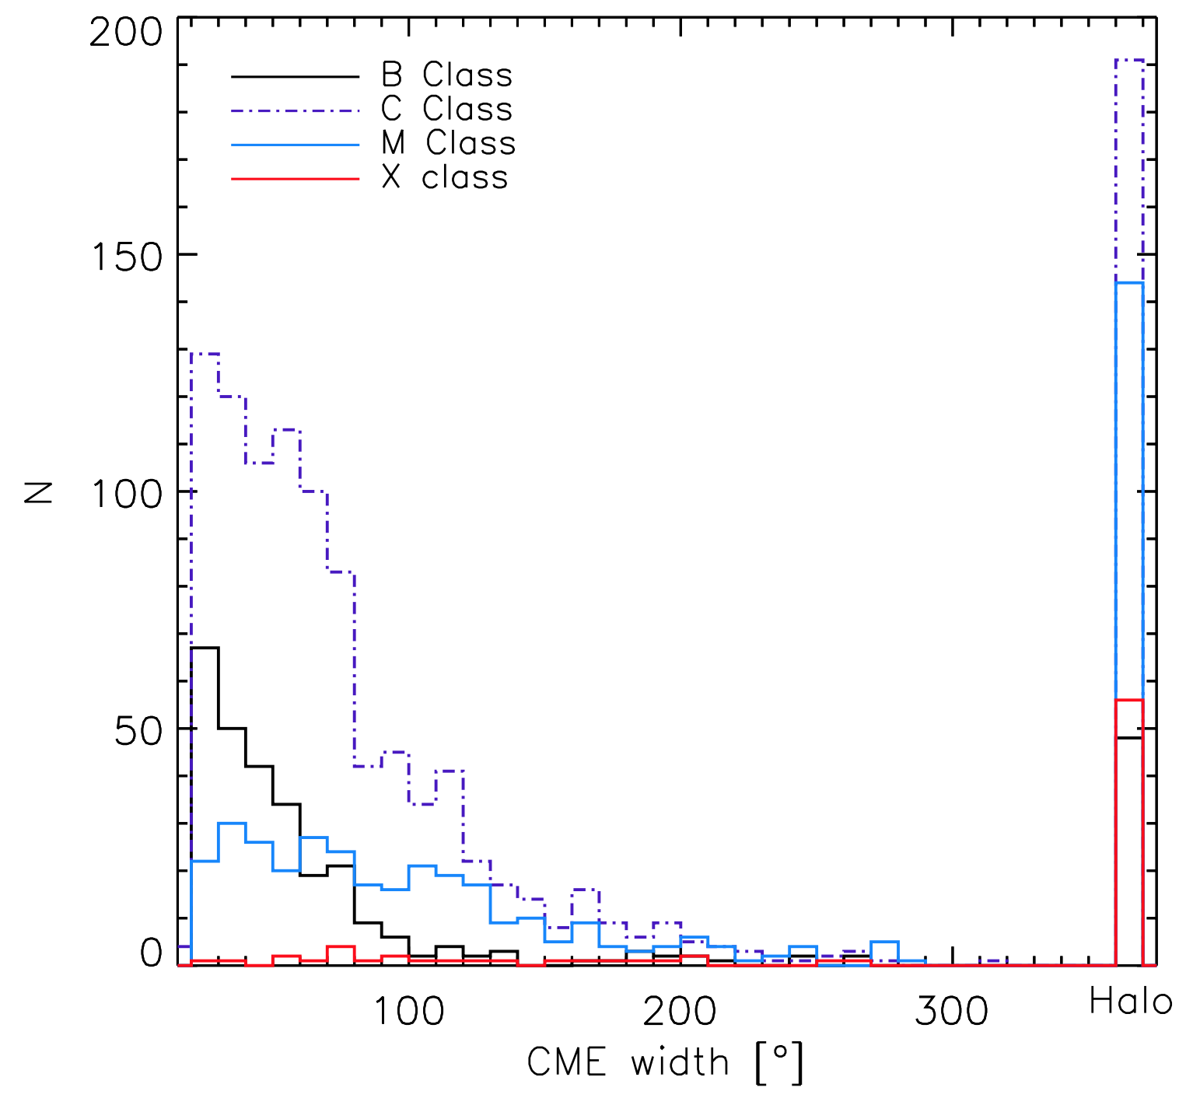
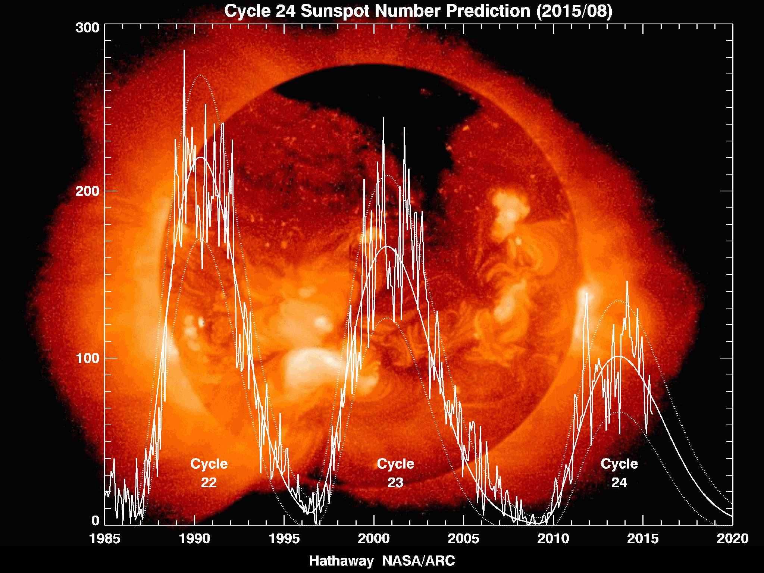
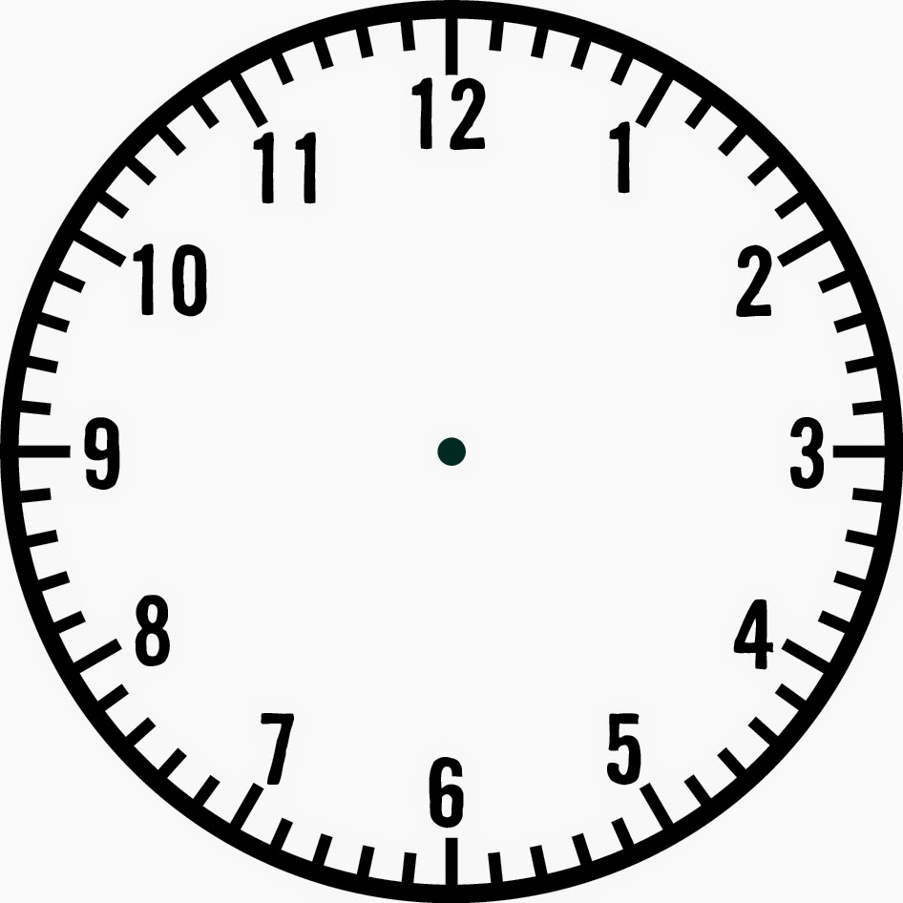

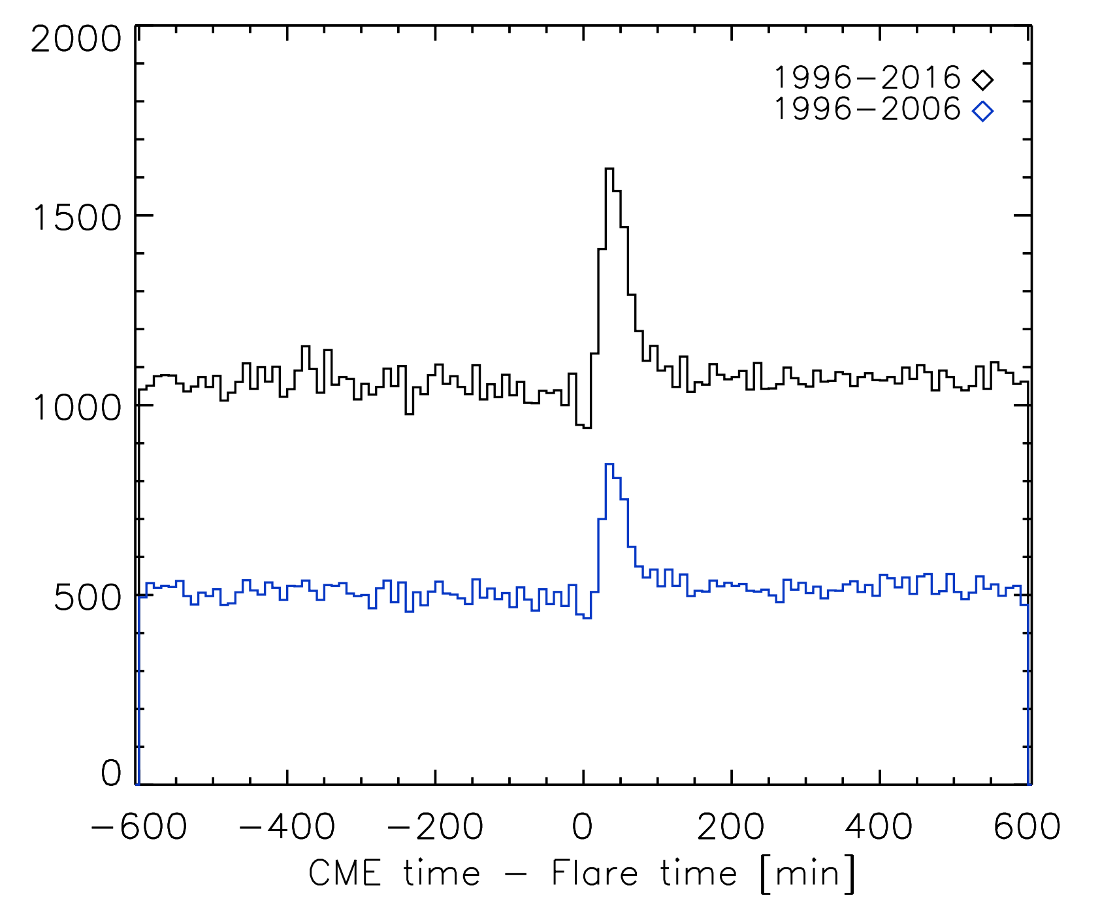
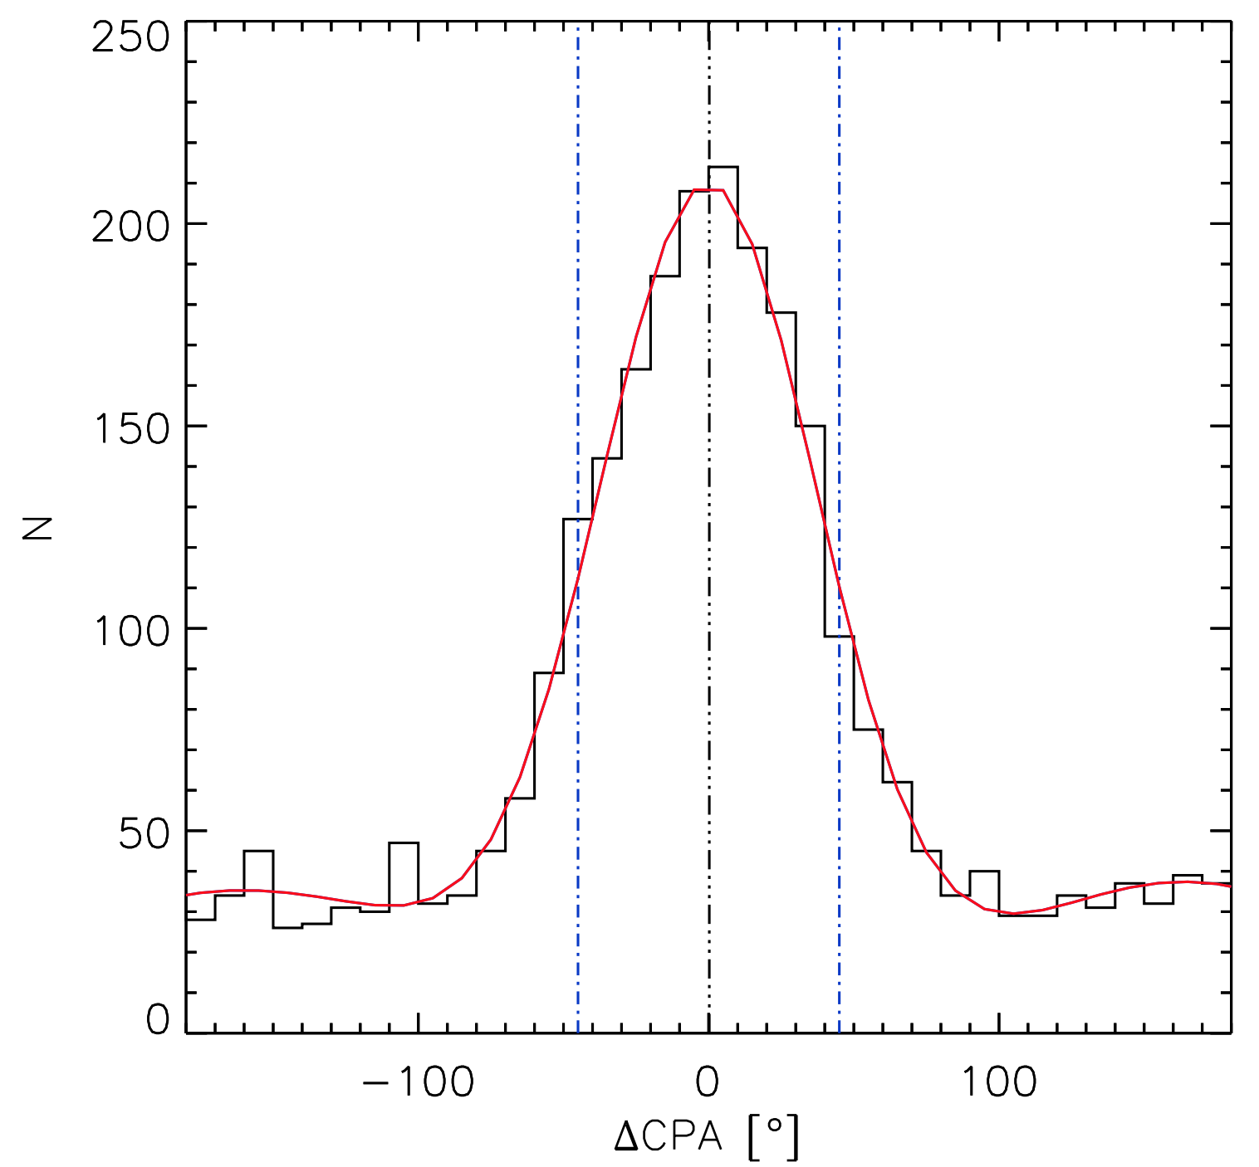
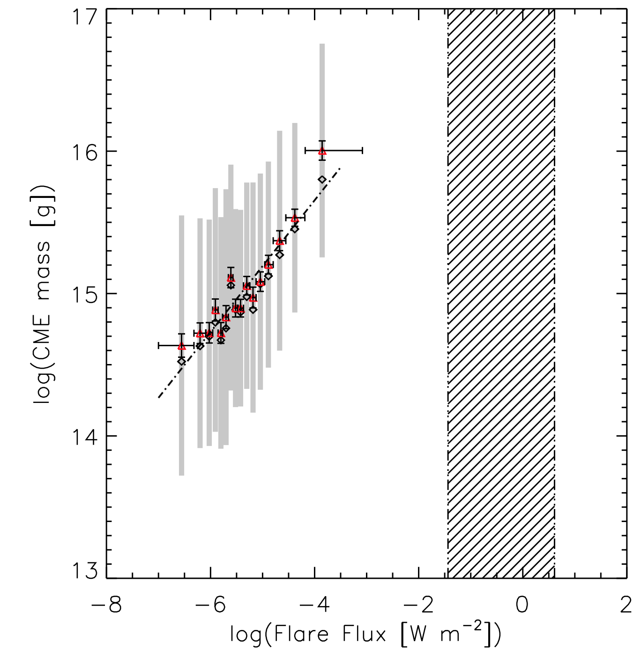
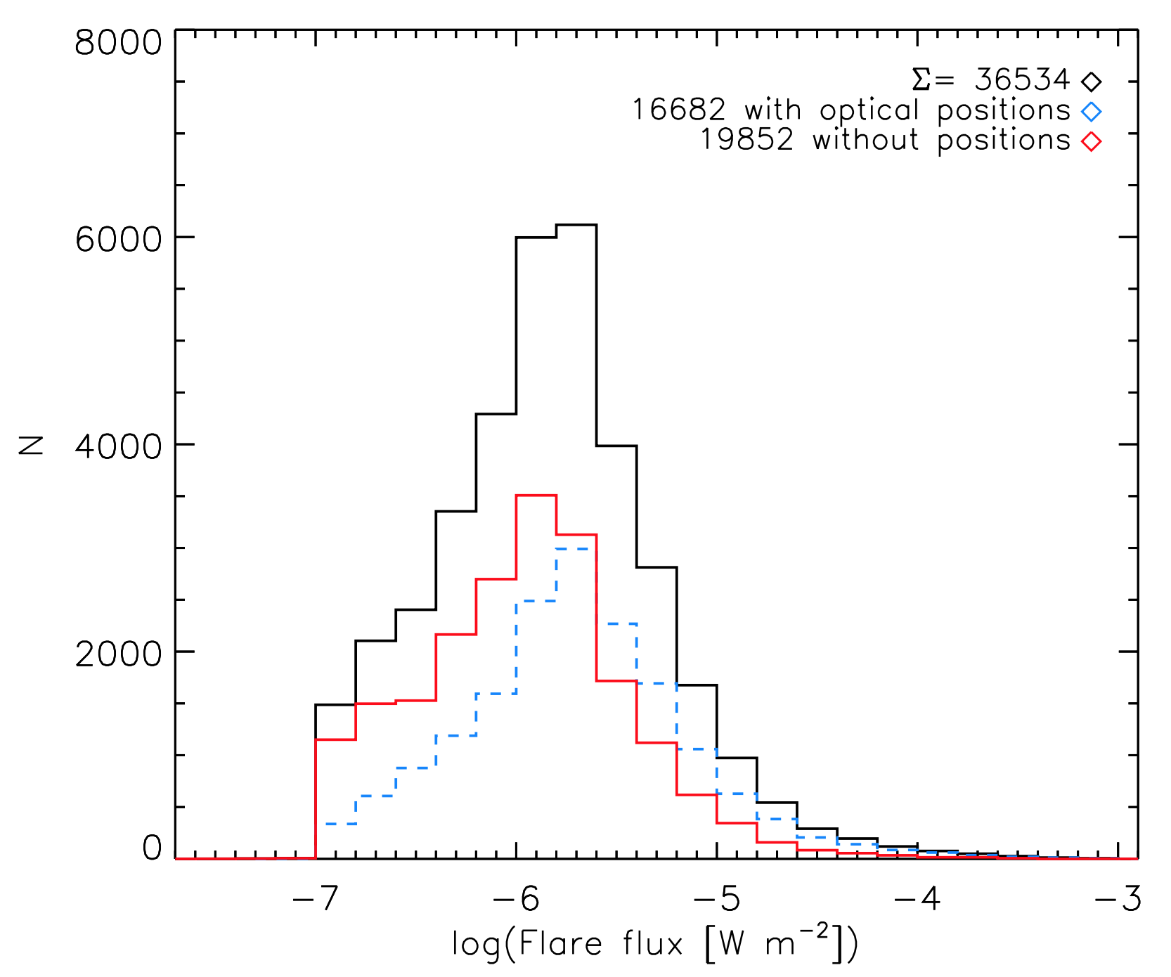
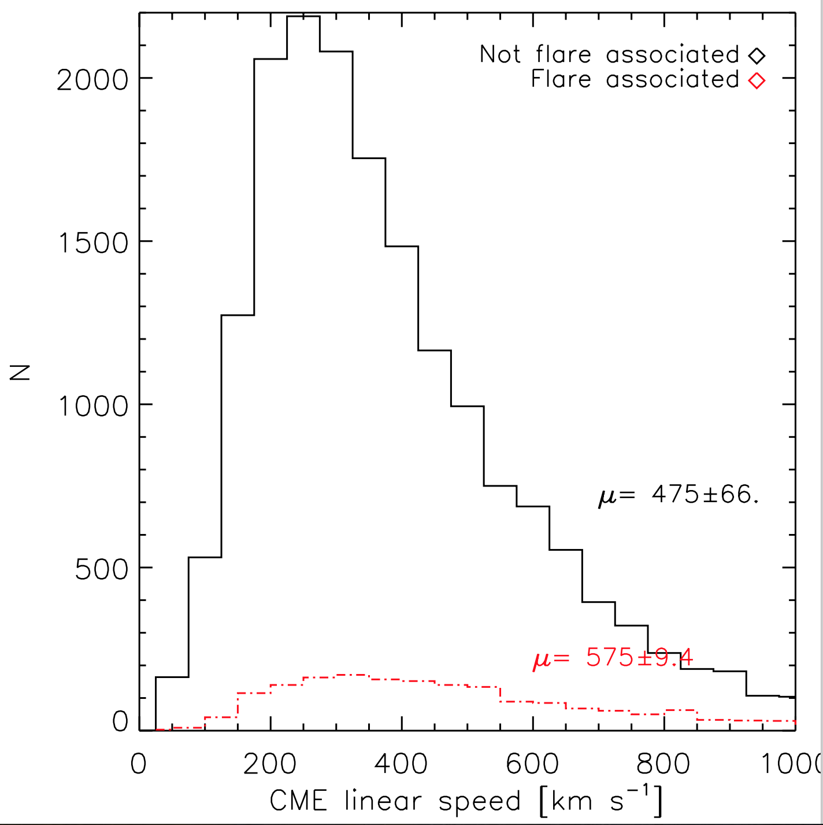
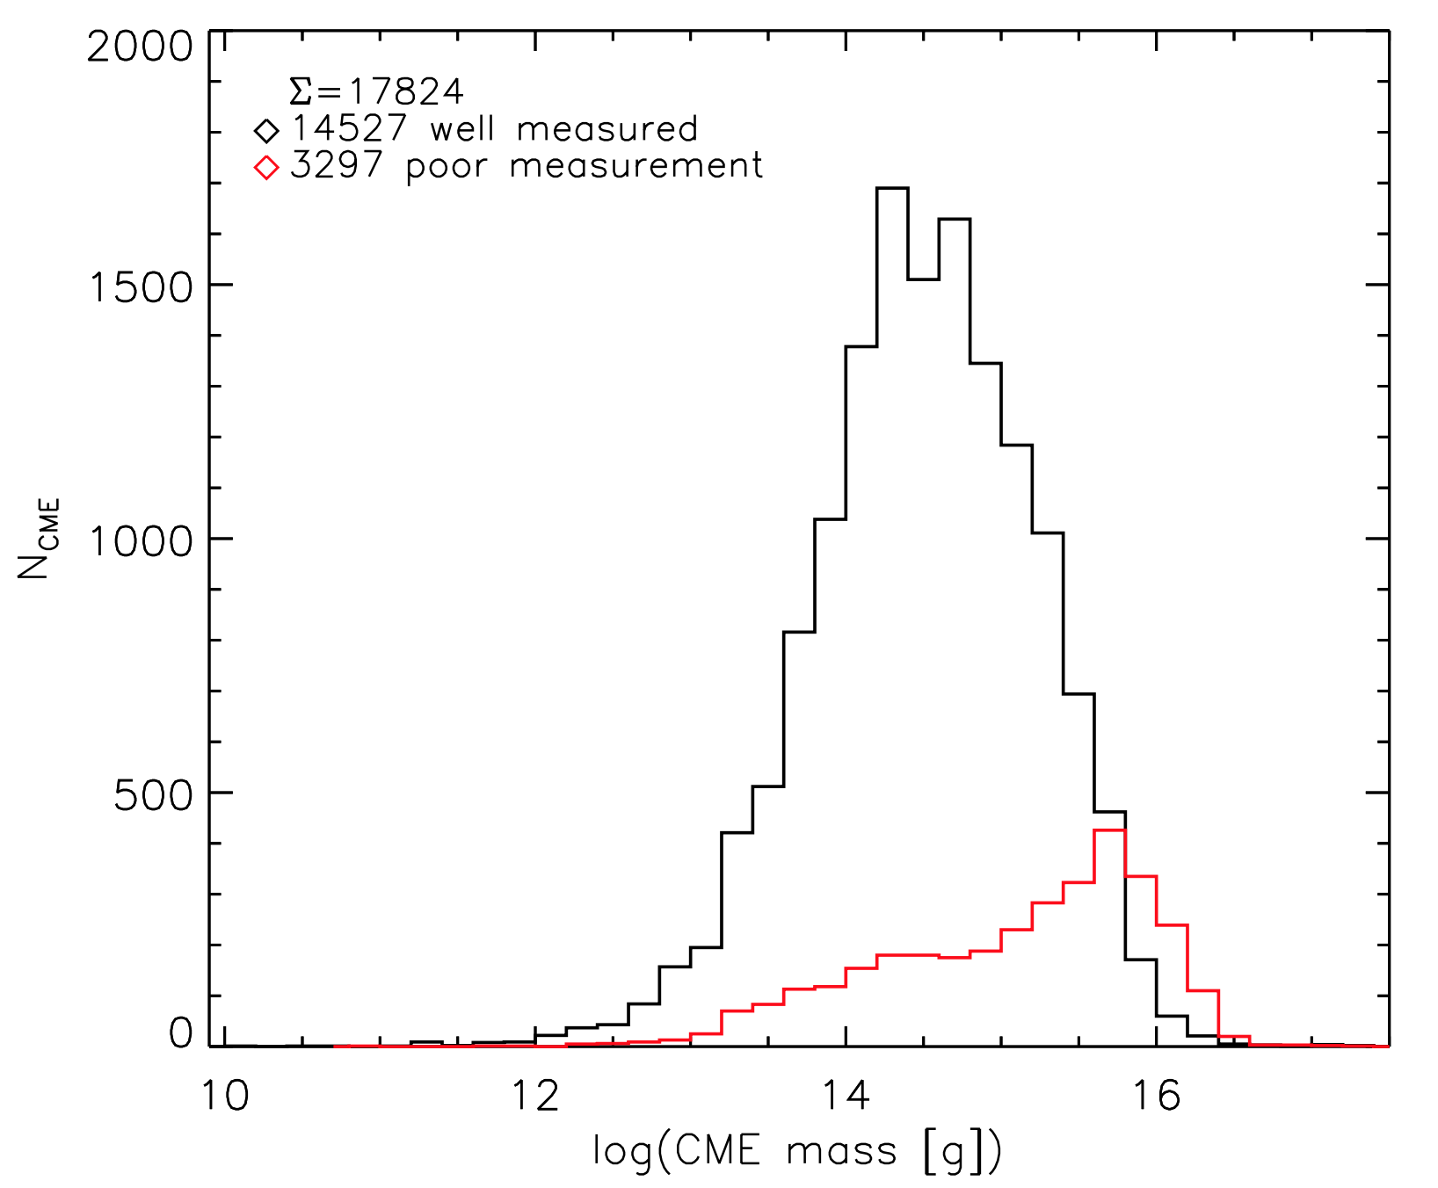
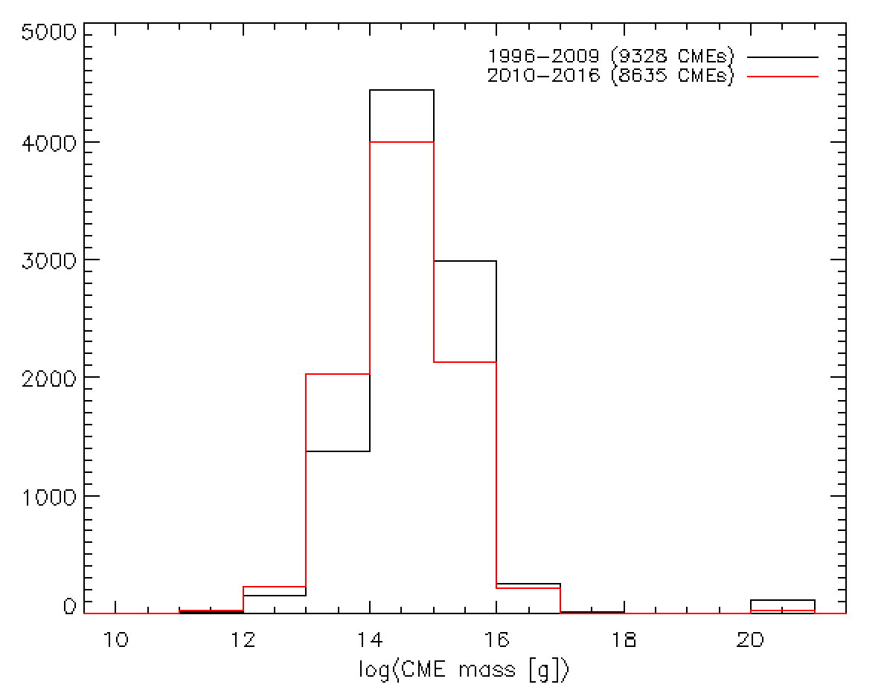
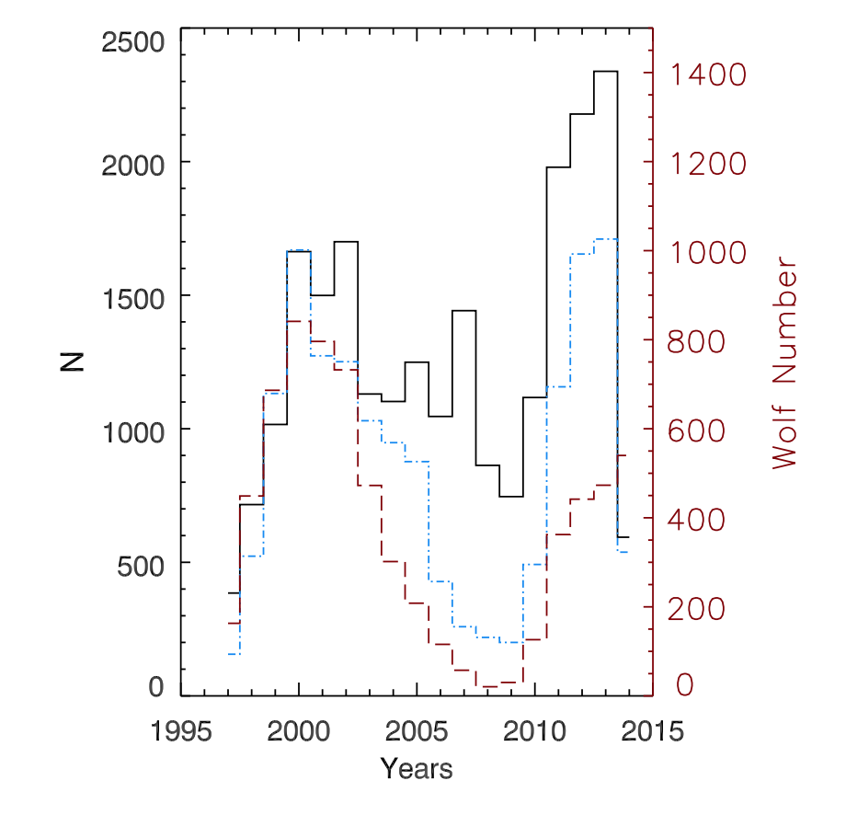
Properties of correlated solar flares and CMEs, revisited: more data, more questions
Alicia Aarnio, Hale Postdoctoral Fellow of Solar, Stellar, and Space Physics, University of Colorado Boulder // University of North Carolina Greensboro
Accessible .pptx
Motivation: explore the relationship between solar flares and coronal mass ejections (CMEs). Develop empirical scaling relationships to apply to space- and exo-weather forecasting, stellar evolution models
Applications: Learning more about solar flares and CMEs: which are correlated? What are their physical properties? Does this have predictive, space weather applications? What might we infer about mass loss in solar-type stars?
Premise: For correlated flares and CMEs---i.e., those arising from the same release of magnetic energy---the properties of the resultant events should be physically related
Data summary:
SOHO/LASCO
C2: 1.5-6R☉
27,639 CMEs
17,256 w/masses
GOES/XRS
Full-disk integrated X-ray flux
36,534 flares
16,682 w/optical positions
Refined time window selection: CMEs 25-95 minutes after flares → narrows sample to 7,067 flare-CME pairs
Applied +/-45 degree spatial cut criterion → 1,539 events (+ 443 halo CMEs)
Results:
CMEs associated with flares
have higher average linear
speeds than CMEs not associated
with flares; tend to decelerate
flare-associated CMEs tend to decelerate
wider CMEs are more massive than narrow CMEs
The stronger the associated flare is, the more massive the CME is
However! Functional form describing relationship may change with cycle, data selection effects must be carefully accounted for.
1996-2006: log(mass) ~ 0.70*log(flux)
the magnitude of a flare-associated CMEs deceleration increases with increasing flare flux
The width of a flare-associated CME is directly correlated with the flux of the flare (B~56°, C~71°, M~94°, X~123°)
1996-2016: log(mass) ~ 0.46*log(flux)
Procedure:
Cross-reference the GOES X-ray flare and LASCO CME databases
Apply temporal and spatial cuts to identify associated events
Use statistical tests to assess significance
X
X
X
X
Aarnio et al. 2011
this work
X
X
Conclusions:
Adding 10 more years of data, previously observed flare/CME physical relationships held
Unlikely there are actually more CMEs in cycle 24 than 23
Effect of cadence on CME sample needs to be carefully considered in establishing scaling laws, especially if extrapolated up to stellar (hatched region, above figure) energies
Questions remain:
what will cycle 24 bring? Will new insights come from ability to detect less massive CMEs? How can this be used for space weather?
How might CME mass/flare flux relationship change on stars, where the field strength and structure is different?
Acknowledgments: The LASCO CME catalog is generated and maintained at the CDAW Data Center by NASA and The Catholic University of America in cooperation with the Naval Research Laboratory. SOHO is a project of international cooperation between ESA and NASA. Thank you to excellent collaborators: Keivan Stassun (Vanderbilt), W. Jeffrey Hughes (BU), Sarah McGregor, Sean Matt (Exeter).
Caveat emptor!
N_{CME} in cycle 24 ≳ 23 …?
Compagnino, Romano, & Zuccarello (2017) compared automated CME detection (blue histogram) to manual CDAW (black), noted cycle 24 discrepancy. LASCO cadence increased June, 2010→ lower mass CME detection rate increased! Comparing data of mixed cadence will yield mixed results…
Abstract -- Outstanding problems in young stellar systems revolve around mass loss, angular momentum evolution, and the effects of energetic events on the surrounding environs. Likewise, the latter of these drives much research into our own system's space weather and the development of predictive algorithms for geomagnetic storms. So dually motivated, we have leveraged a big-data approach to combine two decades of GOES and LASCO data to identify a large sample of spatially and temporally correlated flares and CMEs. In this poster, we mention results of our previous efforts for solar cycle 23 and present an updated catalog inclusive of part of cycle 24, having now doubled the sample. We present changes across the solar cycles, find correlated physical properties in spatially and temporally coincident pairs of events, and have taken further measures to identify sets of related events. Lastly, we make a cautionary note regarding changes in observational cadence that need to be accounted for when aggregating this large data set.
Notes:
QR code goes to http://aliciaaarnio.solar/stellar/files/aarnio_cs20.pptx

